Slide 1

Physical Layer
School of Computer Science Engineering and Technology Bennett University
Greater Noida – 201310

Slide 2
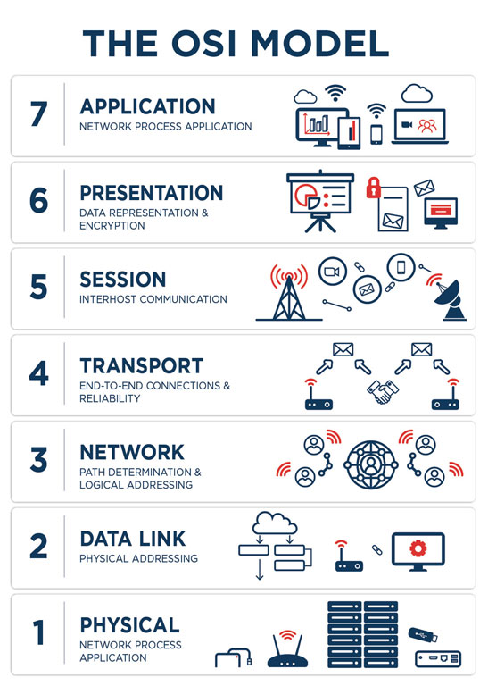
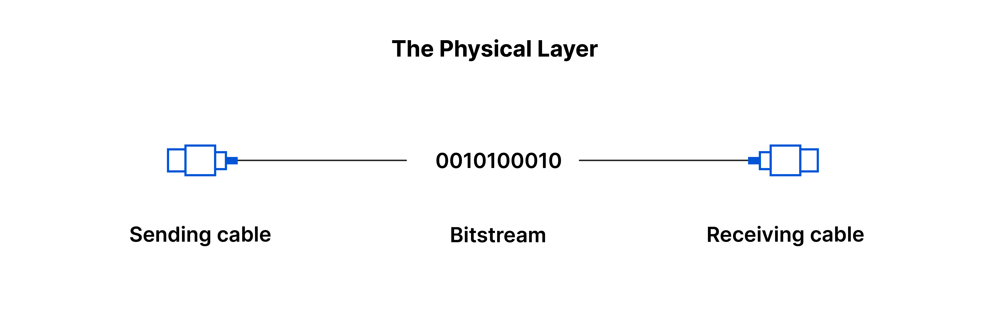
Physical Layer

Slide 3
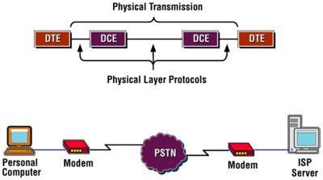
Physical Layer
The physical layer is the lowest layer of the OSI
model.
This layer controls the way unstructured, raw, bit - stream data is sent and received over a physical medium.
This layer is composed of the electrical, optical, and physical components of the network.
It carries the signals for all of the higher layers.
This layer plays with most of the network’s physical
connections -
wireless transmission, cabling, cabling
standards and types, connectors and types, network
interface cards
, and more - as per network
requirements.
Notes:
DTE (Data Terminal Equipment) refers to end devices like computers or routers that generate/consume data, while DCE (Data Communication Equipment) includes devices like modems or switches that handle the actual transmission over the network medium, converting digital signals to appropriate forms (like analog) for the line and back, with the DCE providing clocking signals to the DTE for synchronization.

Slide 4
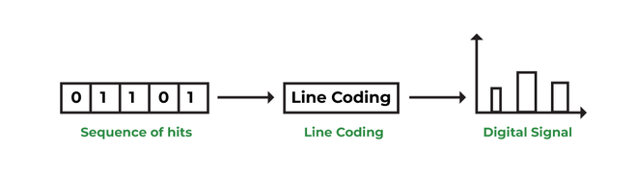
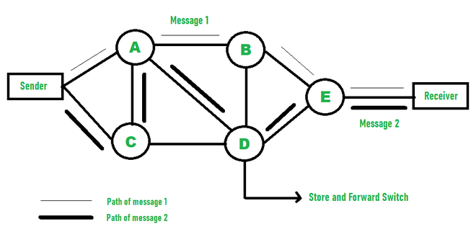
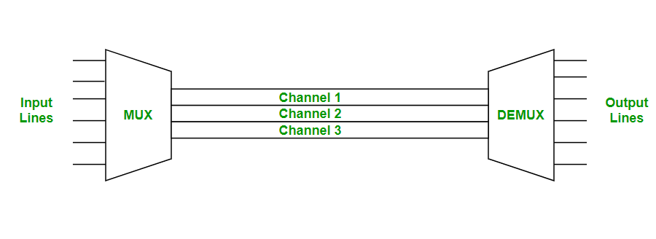
Outline
Physical Layer: Key Techniques
Line coding
Modulation
Multiplexing
Switching
Notes:
Line coding is the process of converting digital data (binary 0s and 1s) into digital signals for transmission over a physical medium. This is necessary to create a pattern of voltage or current fluctuations that represent the binary data. Common line coding schemes include: NRZ (Non-Return to Zero), Manchester Encoding, Bipolar AMI (Alternate Mark Inversion)
Modulation is the process of converting a signal from one form to another, specifically transforming digital data into analog signals to travel over an analog communication channel or wireless medium. This is commonly used in broadband transmission, where a carrier wave's characteristics (amplitude, frequency, or phase) are altered according to the digital data. Amplitude Shift Keying (ASK), Frequency Shift Keying (FSK), Phase Shift Keying (PSK), Quadrature Amplitude Modulation (QAM)
Multiplexing is a technique that allows multiple signals or data streams to share a single physical communication medium or link simultaneously, maximizing the use of available bandwidth. A multiplexer (MUX) combines signals at the sending end, and a demultiplexer (DEMUX) separates them at the receiving end. The main types of multiplexing at the physical layer are: Frequency-Division Multiplexing (FDM), Wavelength-Division Multiplexing (WDM), Time-Division Multiplexing (TDM)
Switching in the context of the physical layer (primarily in traditional telephony networks) refers to establishing a dedicated physical connection between two devices for the duration of a communication session. circuit switching. In a circuit-switched network, once a path is established, the entire bandwidth of the link is reserved for the two communicating parties until the connection is terminated. While the physical layer handles the hardware aspects of this connection, the concept of switching as a mechanism to route data through a network involves higher layers in modern data networks. Hardware Control: Manages the hardware-level routing of signals through physical ports and paths.

Slide 5
Physical Layer: Services
Representation of Bits: Data in this layer consists of stream of bits. The bits must be encoded into signals for transmission. It defines the type of encoding i.e., how 0's and 1's are changed to signal.
Data Rate: This layer defines the rate of transmission which is the number of bits per second.
Synchronization: The sender and receiver are synchronized at bit level.
Interface: Transmission interface between devices and transmission medium.
Line Configuration: Point to Point configuration and Multipoint configuration.
Network topologies: Mesh, Star, Ring, Bus, Tree, and Hybrid.
Transmission Modes: Simplex, Half Duplex, Full Duplex.
Deals with baseband and broadband transmission.

Slide 6
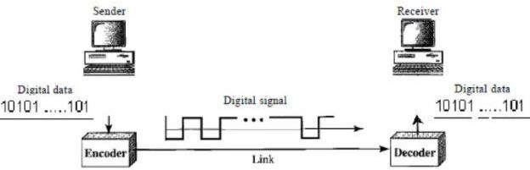
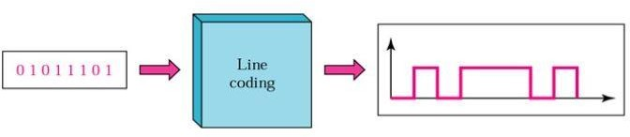
Line coding
Line coding – Conversion of digital data to digital signal.
Sender converts sequence to bits (or encoding) into a digital signal which then again converted into bits (or decoded) by the receiver.

Slide 7
Line coding: Relationship between data and signal
Data elements are being carried whereas signal elements are the carriers.
The number of data elements sent per second is known as bit rate.
The signal that can be sent per second is known as baud rate or pulse rate.
The relationship between them is given as follows:
𝑆 = ^{𝑐𝑁} baud
𝑟
where S = baud rate, c = case factor, N = bit rate, r is the ratio of data element carried by each signal

Slide 8
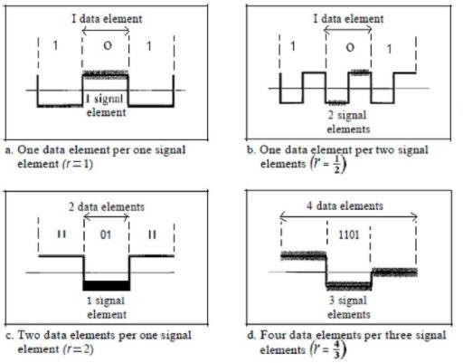
Line coding: Relationship between data and signal
E.g.- A signal is carrying data in which one data element is encoded as one signal element (r = 1). If bit rate is 1 Mbps and case factor c is ½ (in most of the cases) then what will the value of baud rate?
Sol: S = ((1/2) * 1000000) * 1/1 = 500 kbaud

Slide 9
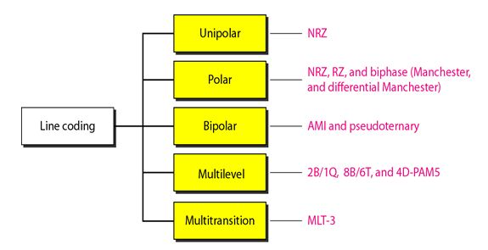
Line coding: Schemes

Slide 10
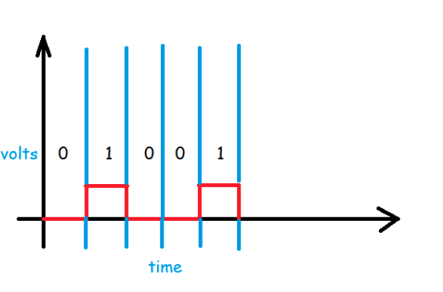
Line coding: Unipolar
It uses only one voltage level.
It is also called On-Off Keying or simply OOK.
Positive voltage is defined by bit 1 and zero voltage defines bit 0.
Two variations:
Non-Return-to-Zero (NRZ): Signal does not return to zero at the middle of the bit.
Return to Zero (RZ): Signal returns to zero at the middle of the bit.
Notes:
Uses only one voltage level (usually positive).

Slide 11
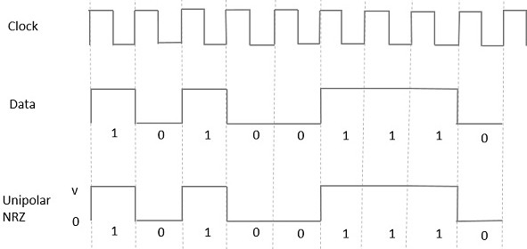
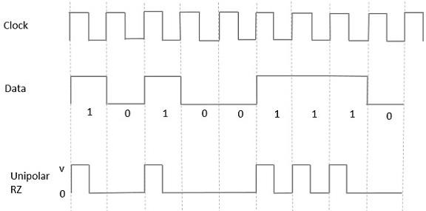
Line coding: Unipolar
Unipolar Return to Zero (RZ)
A High in data represented by a +ve pulse but its duration is
less than the symbol bit duration.
Half of the bit duration remains high, but it immediately returns to zero and shows the absence of pulse for remaining half.
Unipolar Non-Return to Zero (NRZ)
A High (1) in data is represented by a positive
pulse.
A Low(0) in data input has no pulse.
Notes:
Drawback: Large DC component, poor synchronization.

Slide 12
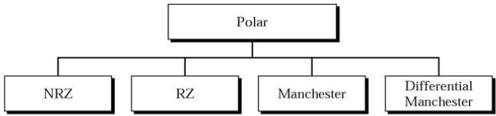
Line coding: Polar
It uses two voltage levels – one positive and the other one negative.
The voltages are on both sides of the time axis.
Binary values; 0 and 1, are used to show +ve and –ve voltage, respectively.
Notes:
Better than unipolar because it reduces DC component.

Slide 13
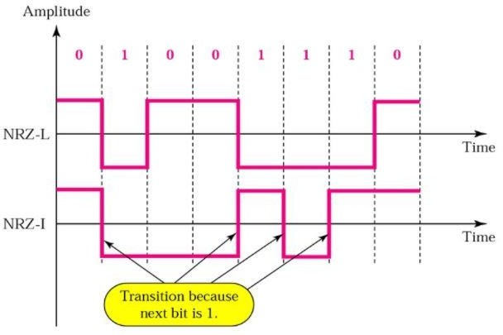
Polar: NRZ
The signal level remains same throughout the bit-period.
Two encoding schemes:
NRZ Level (NRZ-L)
NRZ Inverted (NRZ-I)
NRZ-L
1 = Low level
0 = High level
NRZ-I
For each 1 in the bit sequence, the signal level inverted.
Notes:
Issues: Long runs of identical bits cause synchronization problems.

Slide 14
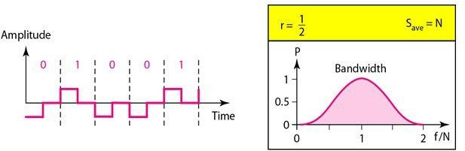
Polar: RZ
RZ scheme uses three values: positive, negative, and zero.
In RZ, the signal changes not between bits but during the bit.
The signal goes to 0 in the middle of each bit, and it remains there until the beginning of the next bit.
Notes:
Improves synchronization.
Drawback: Requires more bandwidth.

Slide 15
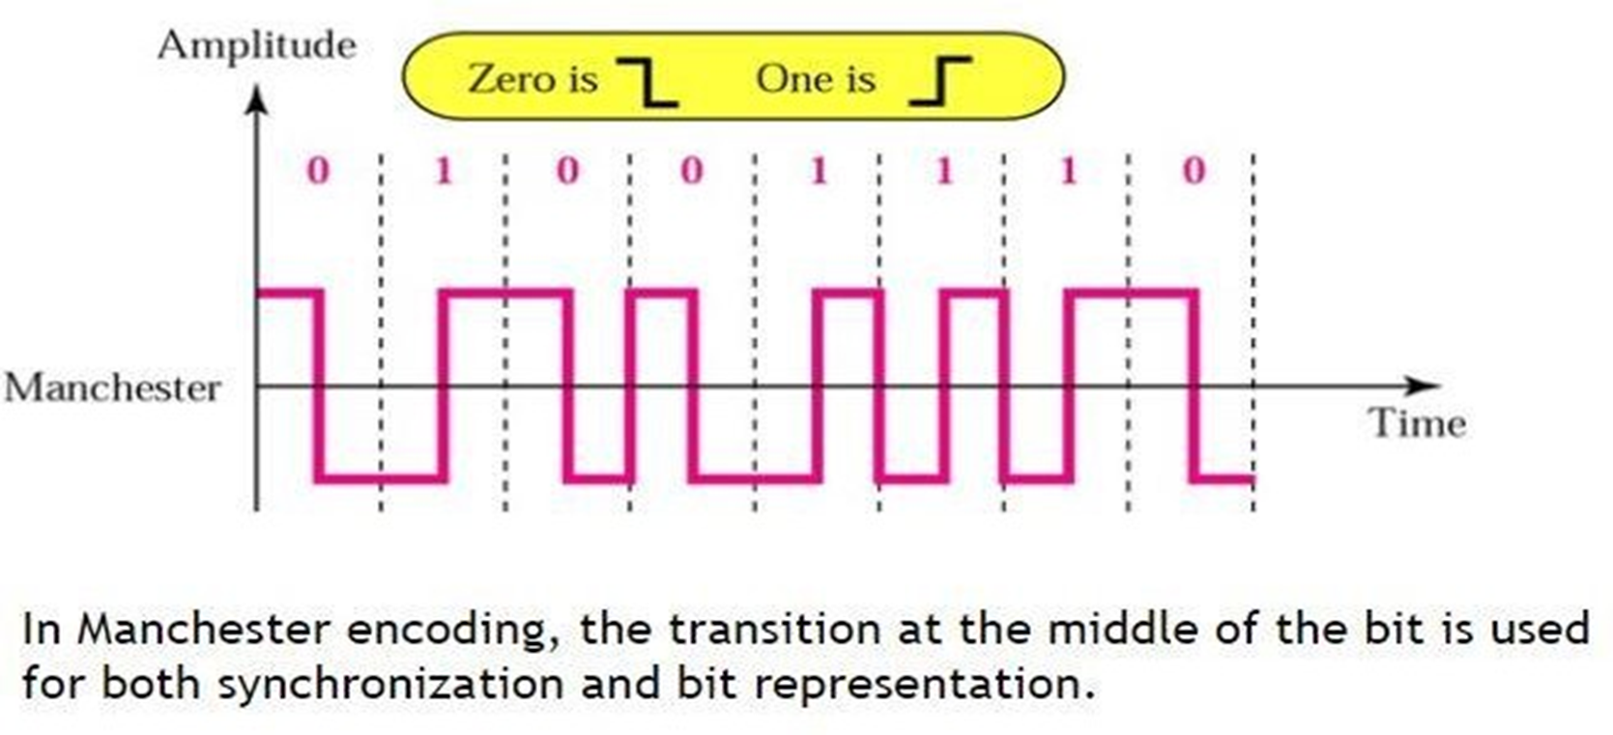
Polar:Manchester
Notes:
Biphase Encoding 1 → High to Low
0 → Low to High Advantages:
Self-synchronizing.
No DC component.
Disadvantage:
Requires double the bandwidth

Slide 16
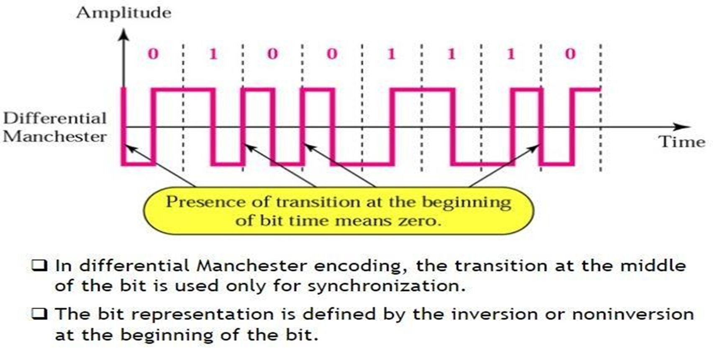
Polar:Diffrential Manchester Manchester
Notes:
Mid-bit transition always present (clock).
Bit value depends on transition at the beginning of the bit.
Advantage: Polarity inversion does not affect data interpretation.

Slide 17
Line Coding: Bipolar
It is also called as multilevel binary scheme.
It is of two types:
Alternate Mark Inversion (AMI): A neutral zero voltage represents binary 0 whereas binary 1s (Mark) are represented by alternating +ve and –ve voltages.
Pseudoternary: Binary 1 bit is encoded as a zero voltage and the binary 0s are represented by
alternating +ve and –ve voltages.
Notes:
Concept
Uses three voltage levels: +V, 0, −V.
Rule
0 → 0 voltage
1 → Alternates between +V and −V

Slide 18
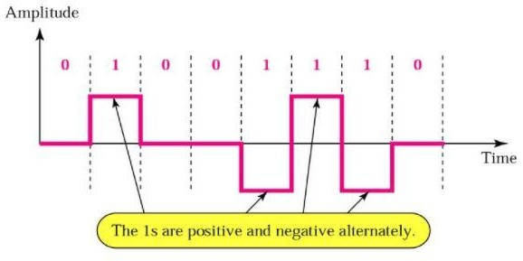
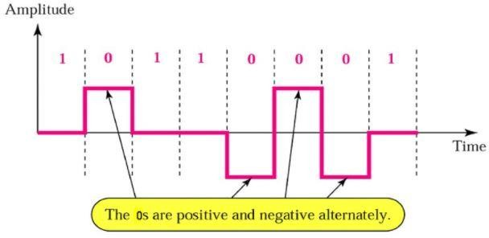
Line coding: Bipolar
AMI
Pseudoternary
Notes:
AMI (Alternate Mark Inversion)
Each successive 1 alternates polarity.
Helps in error detection.
(b) Pseudoternary
Opposite of AMI.
1 → 0
0 → Alternates between +V and −V
Advantages
No DC component.
Easy error detection.
Disadvantages
Long sequences of 0s cause synchronization problems.

Slide 19
Line Coding Self Practice Example
Encode the bit stream 000111101011 using
Unipolar
NRZ-L
NRZ-I
Manchester
Differential Manchester
AMI
Pseudoternary

Slide 20
Switching
A process to forward packets coming in from one port to a port leading towards the destination
Two terms used
Ingress – Data comes on a port
Egress – Data leaves a port or goes out
Switching can be divided into two categories:
Connectionless: Data is forwarded on behalf of forwarding table and no manual intervention. It is not secure
Connection-oriented: A circuit is pre-established along with the path between both endpoints. Data is forwarded on the
circuit and the circuit can be kept for future use or can be turned down immediately.

Slide 21
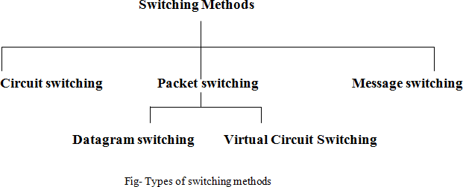
Switching : Techniques

Slide 22
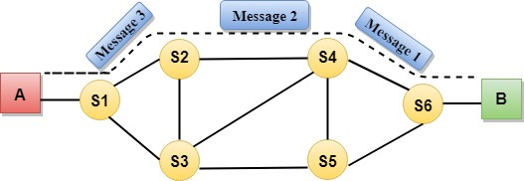
Switching : Circuit Switching
A dedicated path is established between sender and receiver and will remain to exist until the
connection is terminated.
Circuit switching in a network operates in a similar way as the telephone works.
A complete end-to-end path must exist before the communication takes place.
Circuit switching has 3 phases:
Circuit establishment
Data transfer
Circuit Disconnect

Slide 23
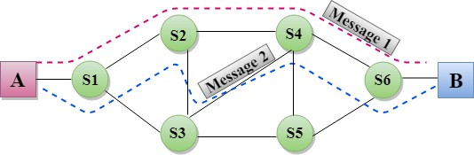
Switching : Message Switching
Message is transferred as a complete unit and forwarded using store and forward mechanism.
No dedicated path is established between the sender and receiver.
The destination address is appended to the message and is routed efficiently using dynamic path.
Each node stores the entire message and then forward it to the next node.
Not suited for streaming media and real-time application.

Slide 24
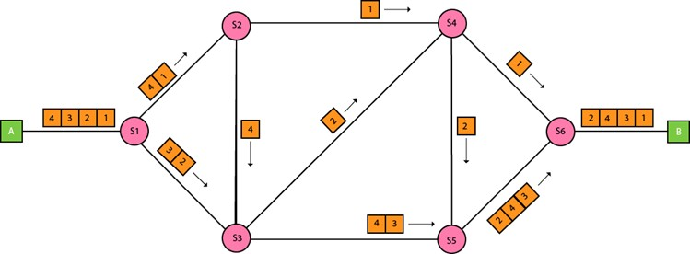
Switching : Packet Switching
Message is broken into individual chunk called as packets that is sent individually in the network.
Every packet contains some information in its headers such as source address, destination address
and sequence number.
Packets will travel across the network, taking the shortest path as possible.
Sequence number helps the receiver to reorder the packets, detect missing packets, and send acknowledgement.

Slide 25
References
https://circuitglobe.com/difference-between-circuit-switching-and-packet-switching.html
https://www.javatpoint.com/computer-network-switching-techniques
https://www.studytonight.com/computer-networks/multiplexing-in-computer-networks
https://www.javatpoint.com/multiplexing-in-computer-network
https://data-flair.training/blogs/multiplexing-in-computer-network/
https://www.youtube.com/watch?v=-HlJ4psu5aU&t=350s
https://www.youtube.com/watch?v=mHvV_Tv8HDQ

